Slide 1
Zurich Hdawg Synchronization Methods
Richard McManus
March 2023

Slide 2
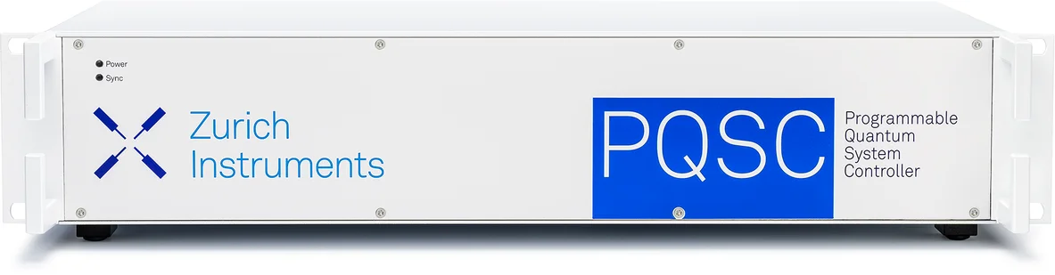
Method 1: Zurich PQSC

Slide 3
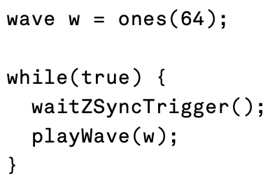
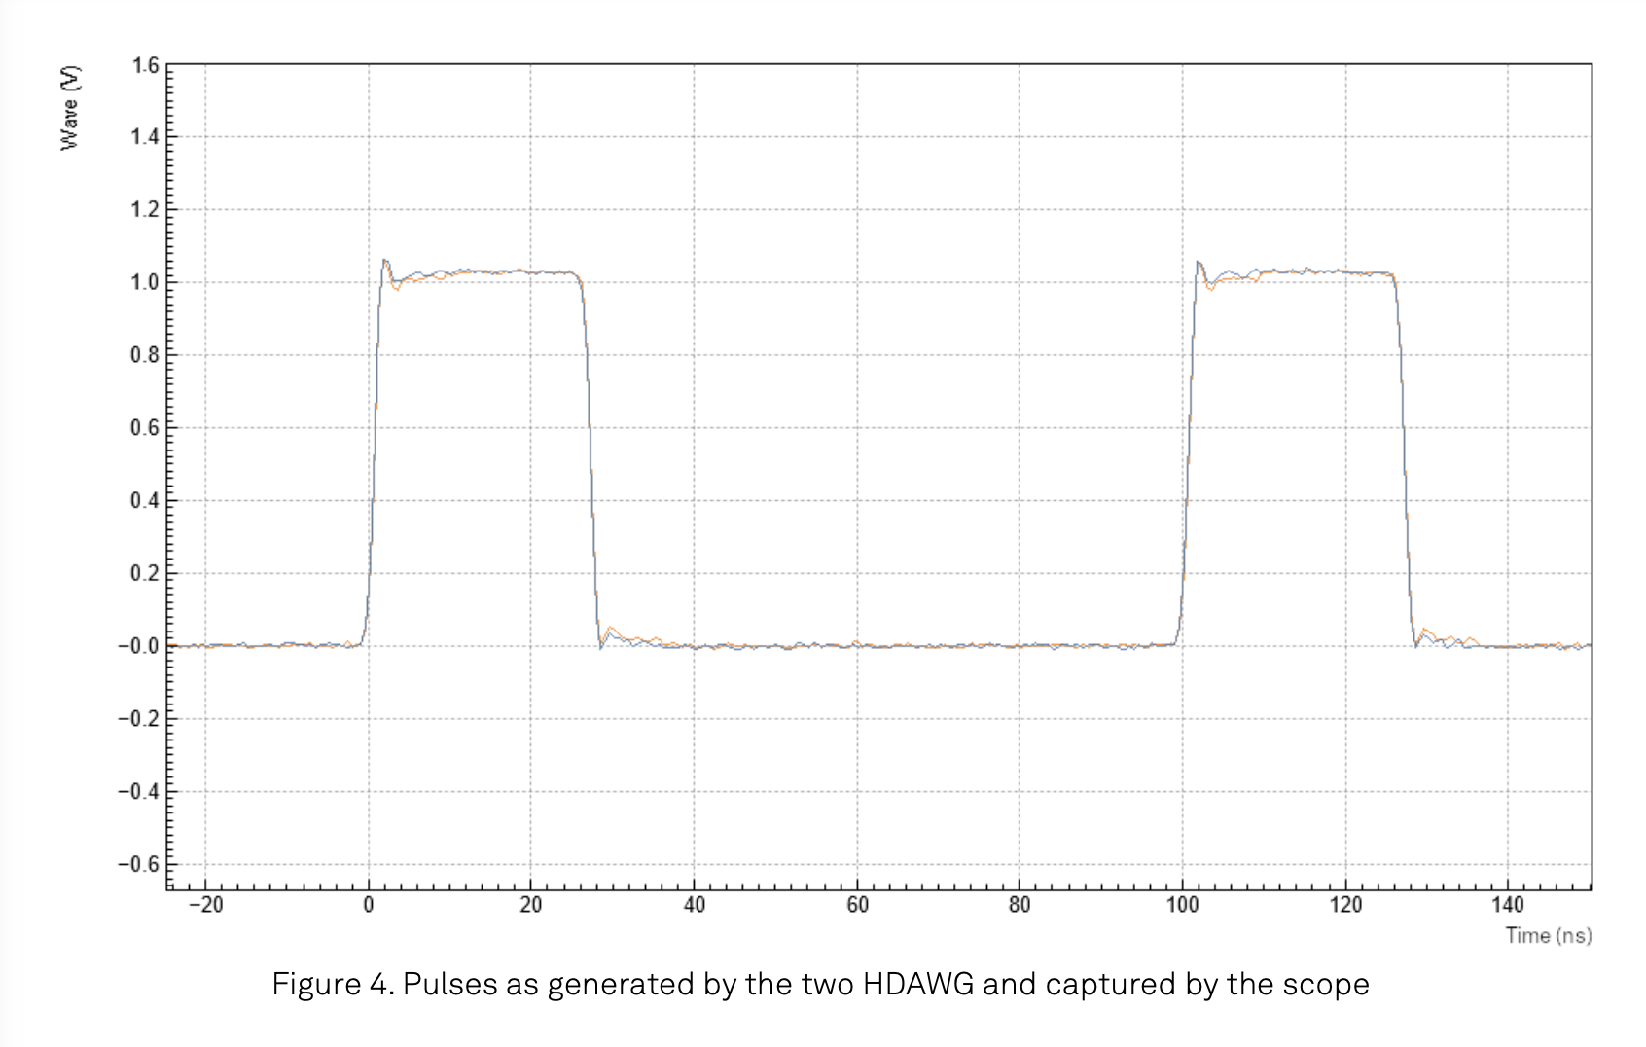
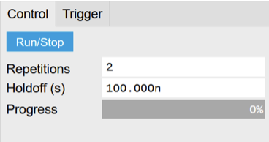
Zurich Example PQSC Synchronization (Synchronization of multiple HDAWGs)
AWG Sequencer
PQSC Output

Slide 4
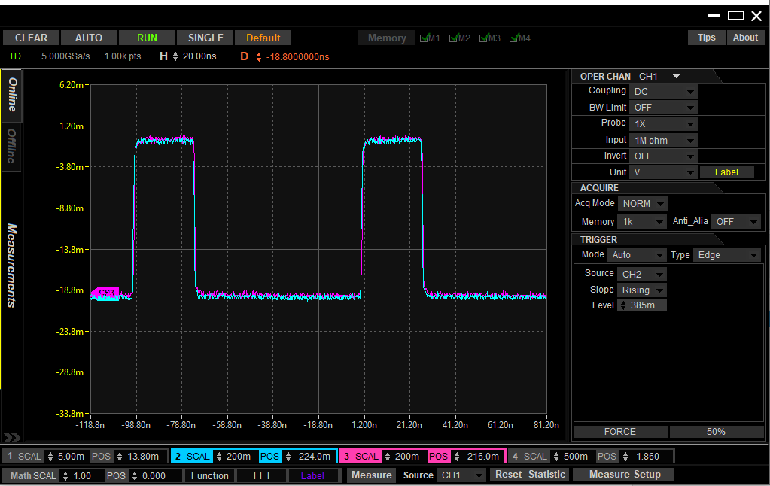
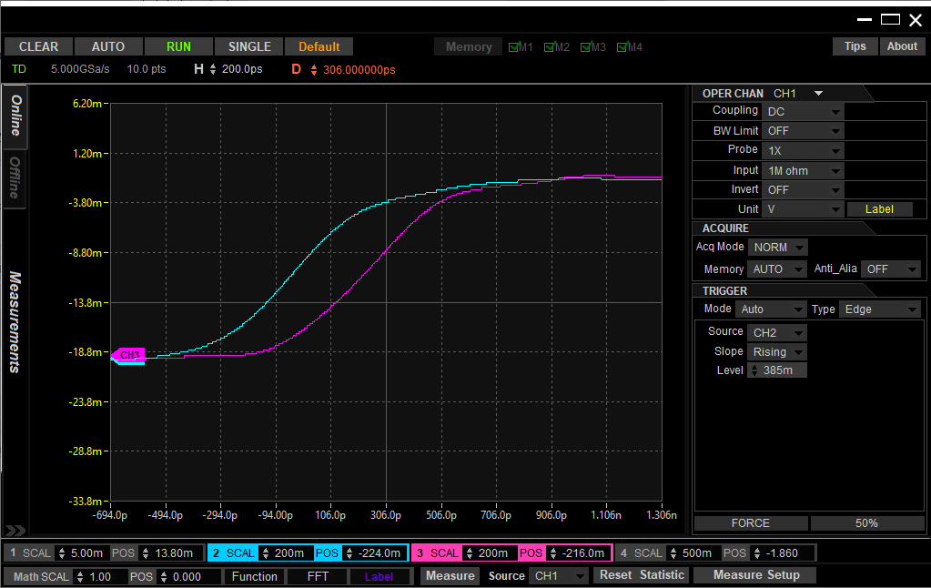
Zurich Example PQSC Synchronization Recreated
20ns per division
200ps per division
Delay of ~250ps

Slide 5
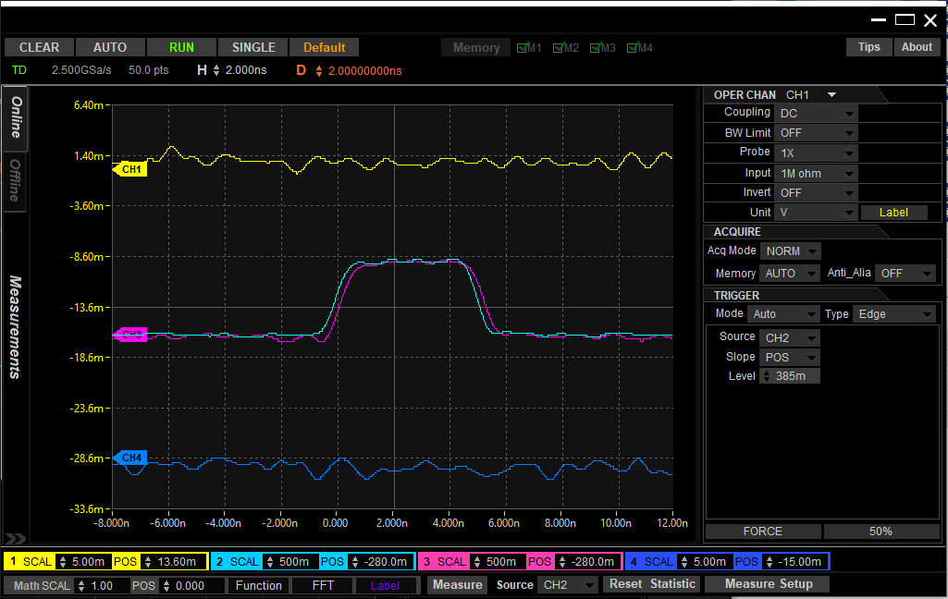
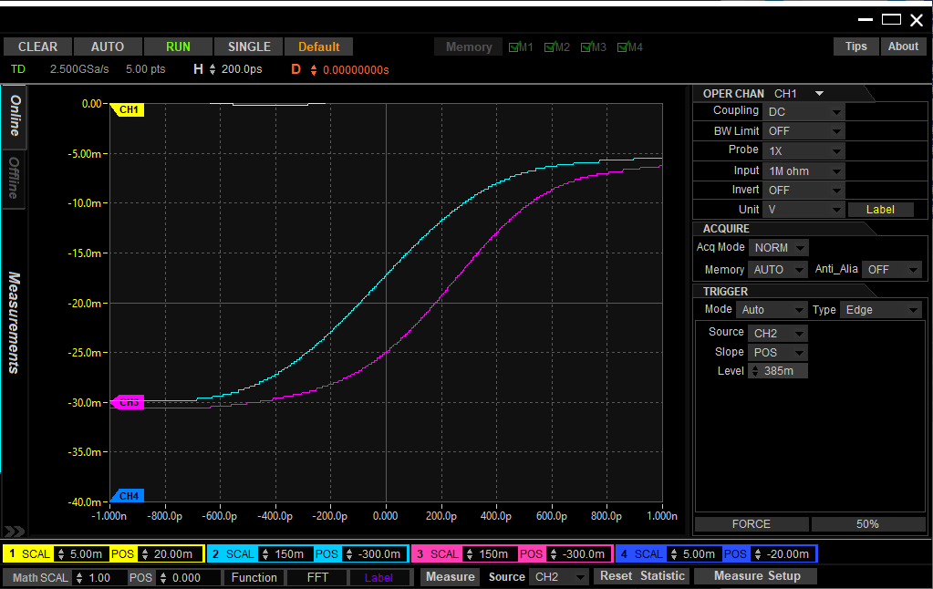
Zurich PQSC Ramp Wave Test (75 Mhz), Wave 8 of 12, Two HDawgs
2ns per division
200ps per division
Delay of ~250ps

Slide 6
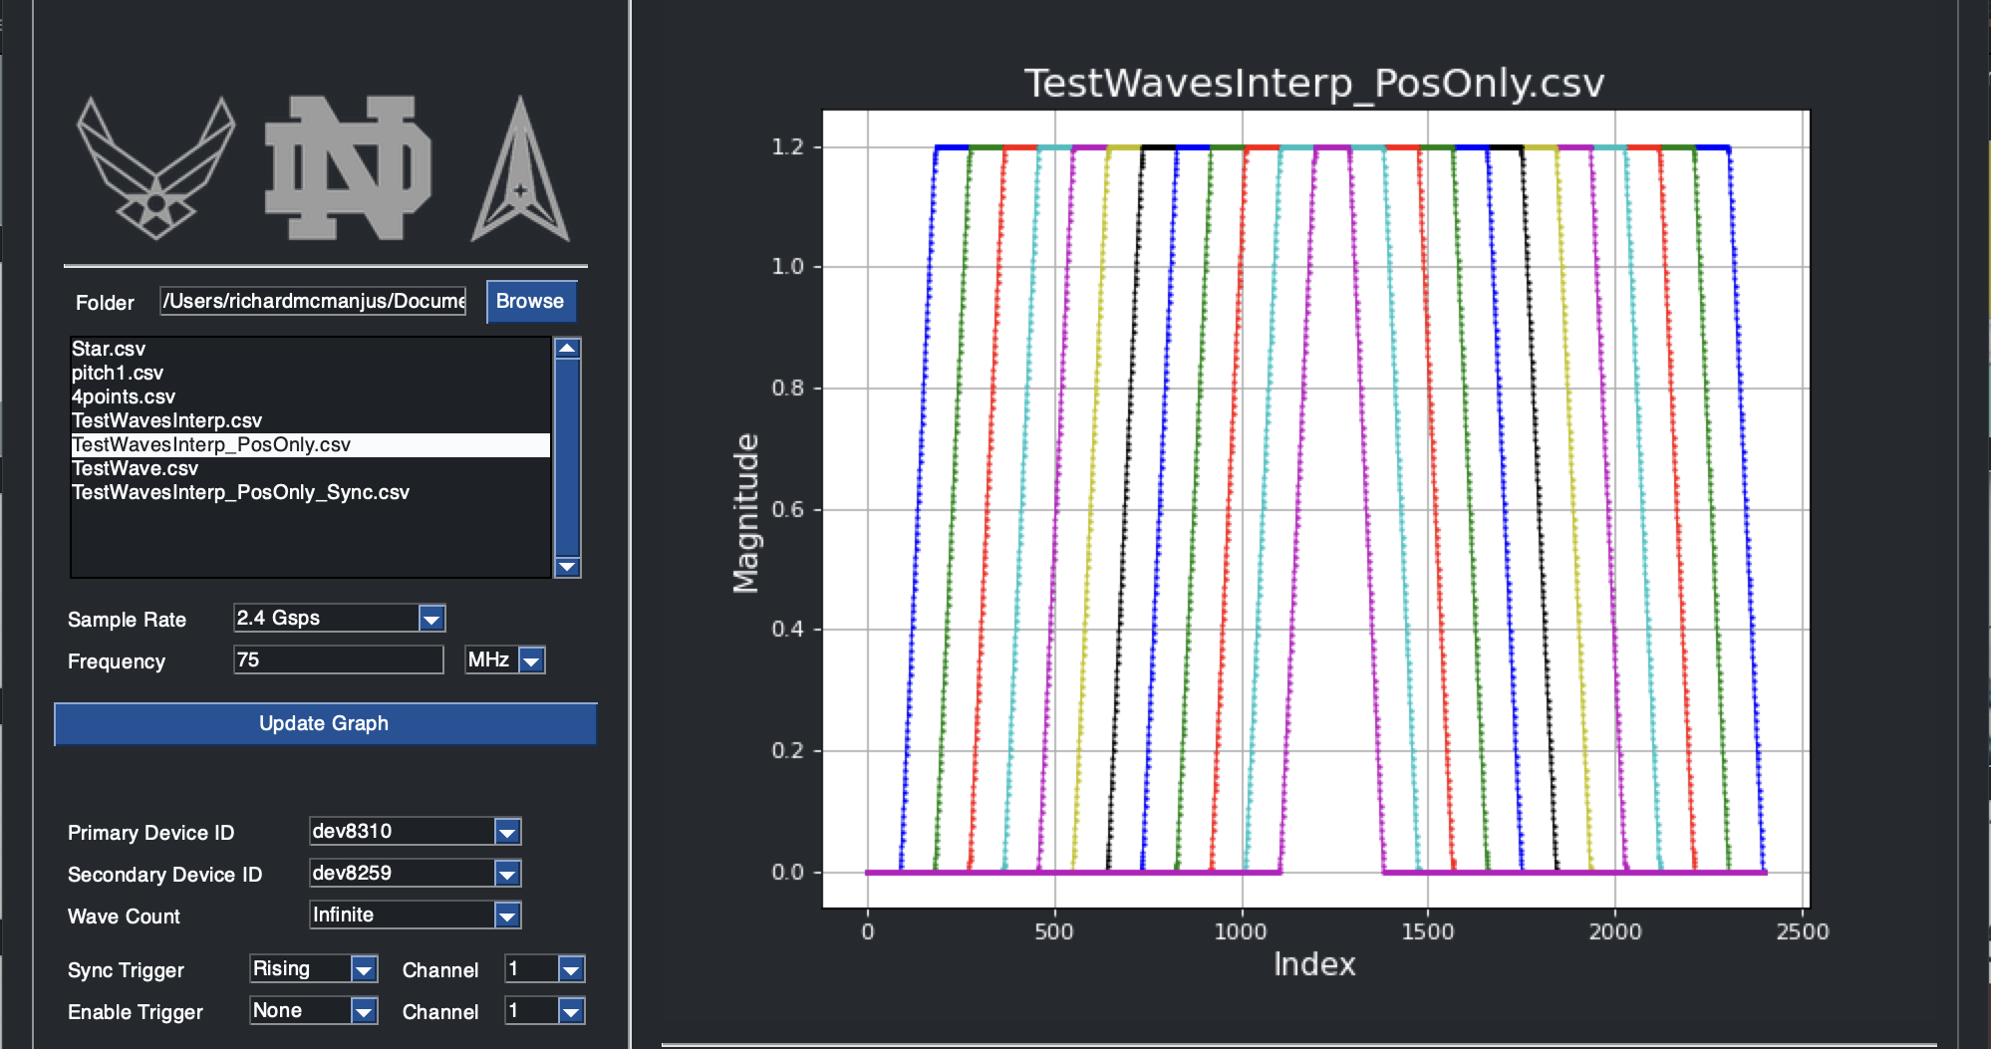
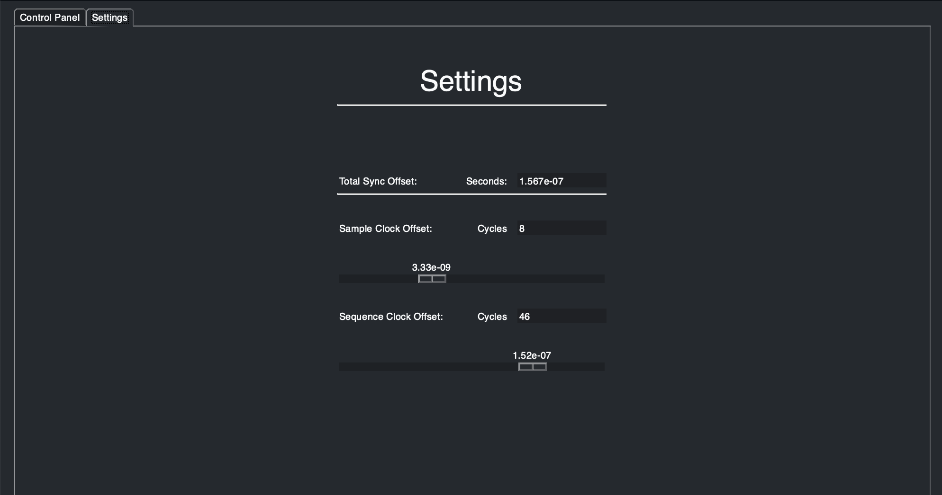
Method 2: Delay Compensation (Python)

Slide 7
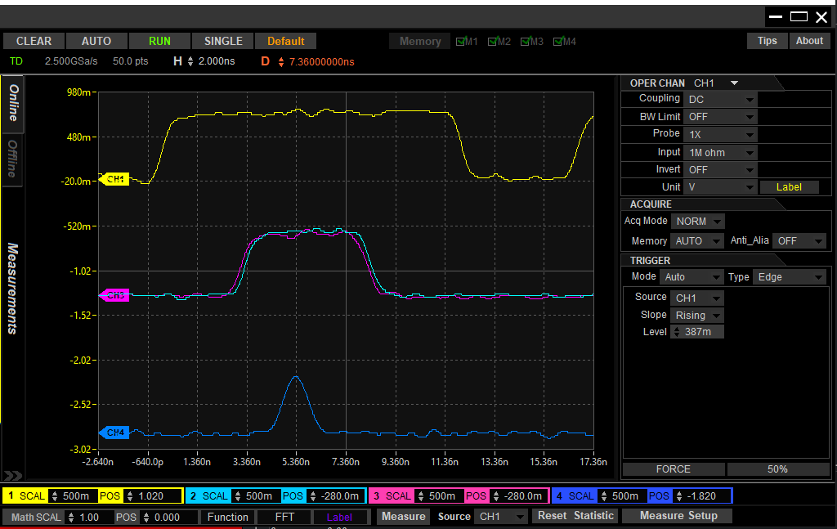
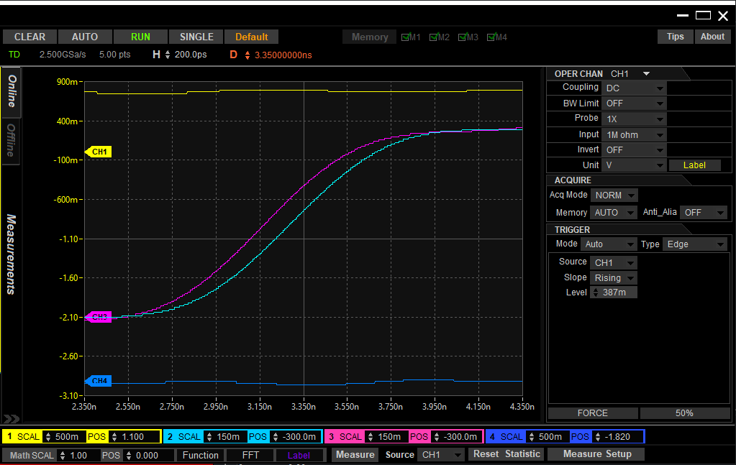
Delay Compensation Ramp Wave test (75 Mhz), Wave 8 of 12, TWO HDAWGS
2ns per division
200ps per division
Delay of ~150ps

Slide 8
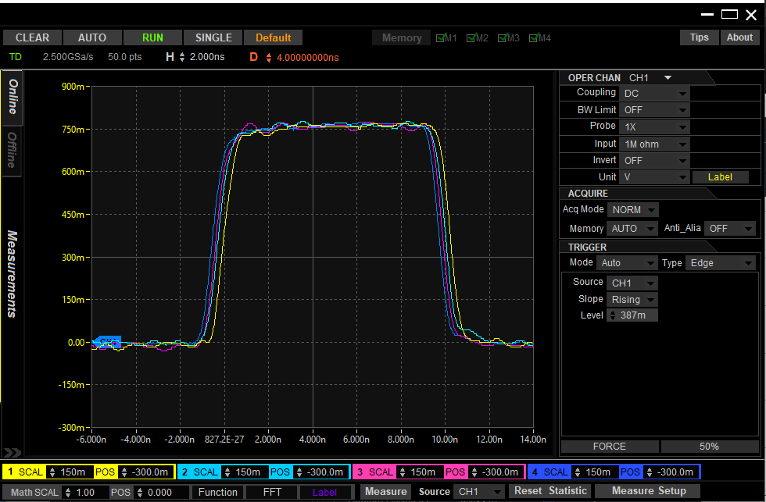
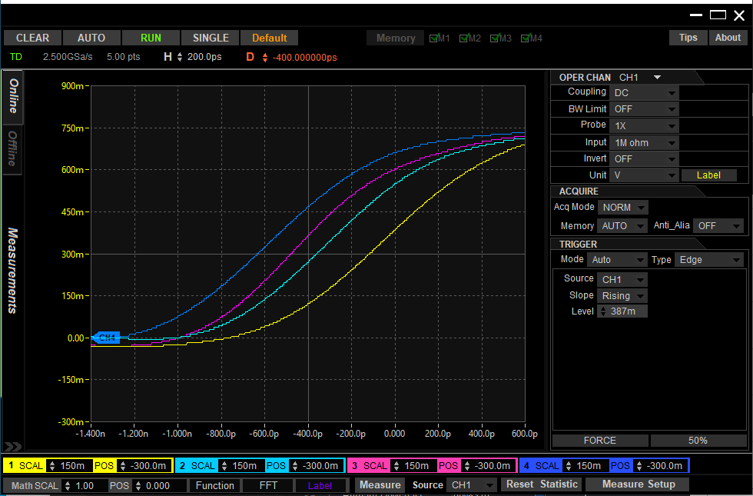
Delay Compensation Ramp Wave test (37.5 Mhz), Wave 8 of 12, TWO HDAWGS
Scope Ch. | HDAWG # | HDAWG CH.
1 | 1 | 1
2 | 1 | 2
3 | 2 | 1
4 | 2 | 2
2ns per division
Delay between HDAWGs (Scope Ch. 2 and Ch. 3): 100ps – 150ps
Delay between channels of HDAWG #1 (Scope Ch. 1 and Ch. 2): 200ps – 250ps
Delay between channels of HDAWG #2 (Scope Ch. 3 and Ch. 4): 150ps – 200ps
200ps per division

Slide 9
Comparison of Methods
Method 1: Zurich PQSC
Delay of ~250ps
Equal to or greater than the delay between subsequent channels of the same HDAWG
Method 2: Delay Compensation
Delay of ~150ps
Equal to or less than the delay between subsequent channels of the same HDAWG

